Slide 1

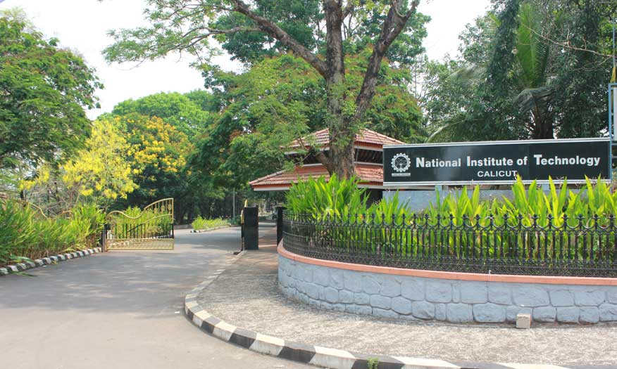
National Institute of Technology
CALICUT
NIT Calicut is a premier technical university located in Calicut, Kerala India. Established in 1961. NIT Calicut has a long history of providing students with a well-rounded education that combines rigorous academic programs with opportunities for hands-on learning and research.

Slide 2

Courses
Computer Science and Engineering
Electrical and Electronics Engineering
Mechanical Engineering
Civil Engineering
Chemical Engineering
Electronics and Communication Engineering
Information Technology

